Slide 1
Introduction to REACTIVE PROGRAMMING & reactive relational database connectivity
JUNE 2019

Slide 2
agenda
Imperative web app demo
Introduction to spring webflux
Introduction to r2dbc
Reactive transaction management
Reactive programming impediments

Slide 3

Demo: Imperative web app

Slide 4
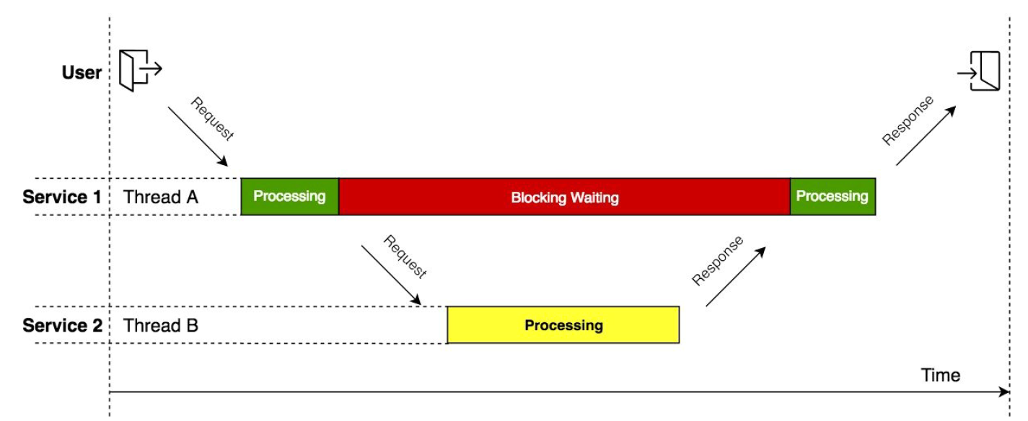
Thread per request model

Slide 5

Little’s law
L = w

Slide 6

Little’s law
L = w
Tomcat, 200 Threads(L), 100 ms/request(W) = 2000 request/second( )

Slide 7

Spring Webflux
Project reactor

Slide 8
Reactive programming
Reactive programming: a new answer to an old question

Slide 9
Reactive programming
Reactive programming: a new answer to an old question
How do I handle more users?

Slide 10
Reactive programming
Reactive programming: a new answer to an old question
How do I handle more users?
The thread per request model runs out of gas very quickly since there’s a finite amount of threads the JVM can handle

Slide 11
Reactive programming
More for scalability than for speed

Slide 12
Reactive programming
More for scalability than for speed
Reactive programming is the next frontier for high-efficiency java applications
Fundamentally non-blocking
Key differentiator from async is reactive backpressure

Slide 13
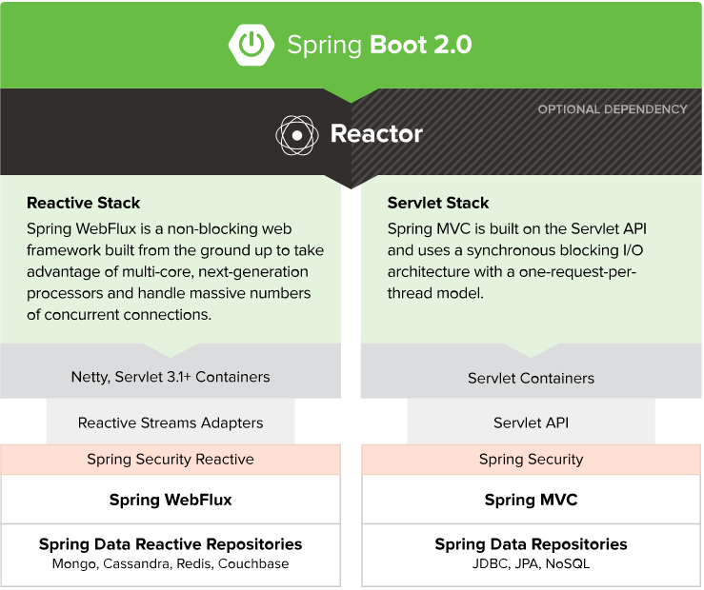

Slide 14
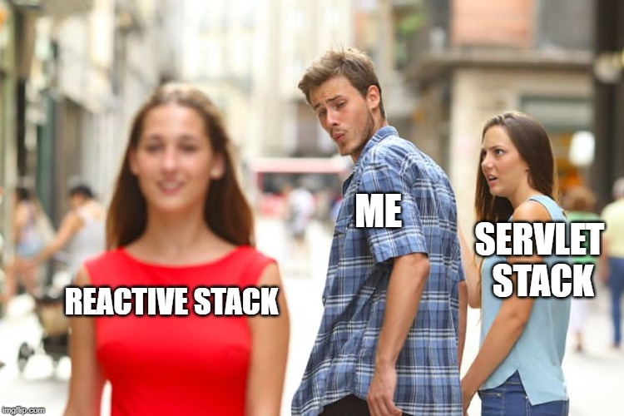

Slide 15
Let’s code

Slide 16
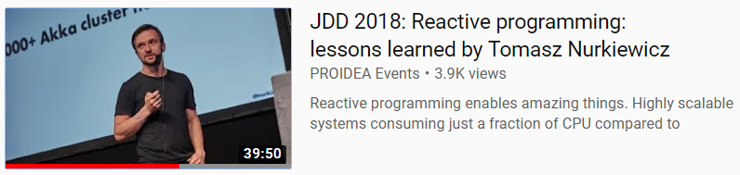
Is it worth it?
https://www.youtube.com/watch?v=5TJiTSWktLU

Slide 17
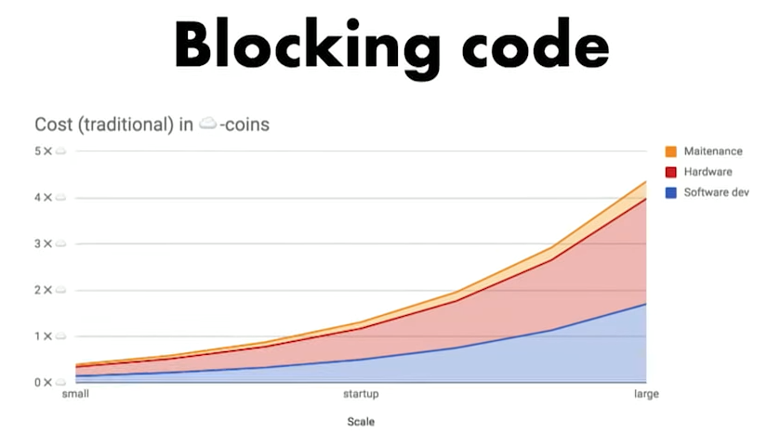
Reactive benefits

Slide 18
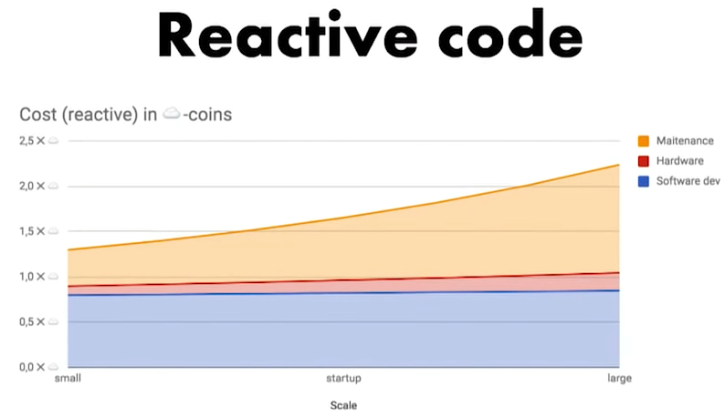
Reactive benefits

Slide 19
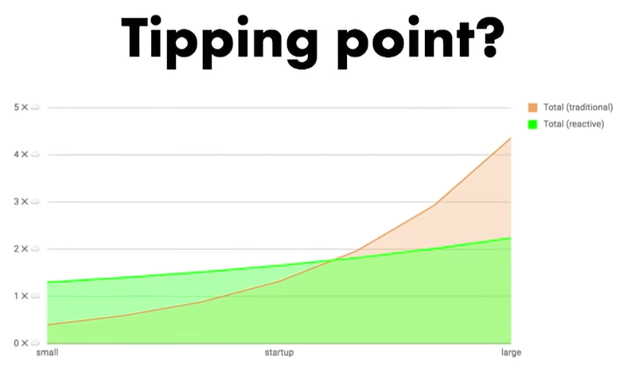
2b || !2b Reactive?

Slide 20
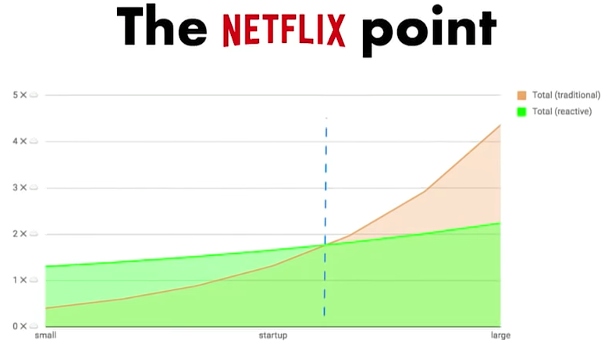
2b || !2b Reactive?

Slide 21
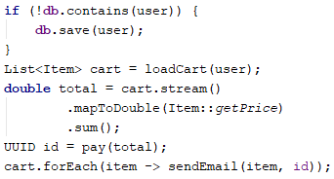
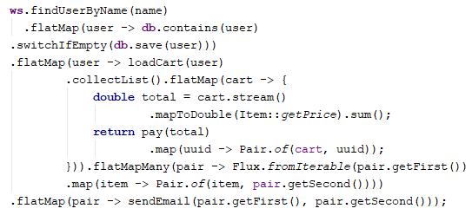
Reactive vs imperative
The choice is yours…

Slide 22
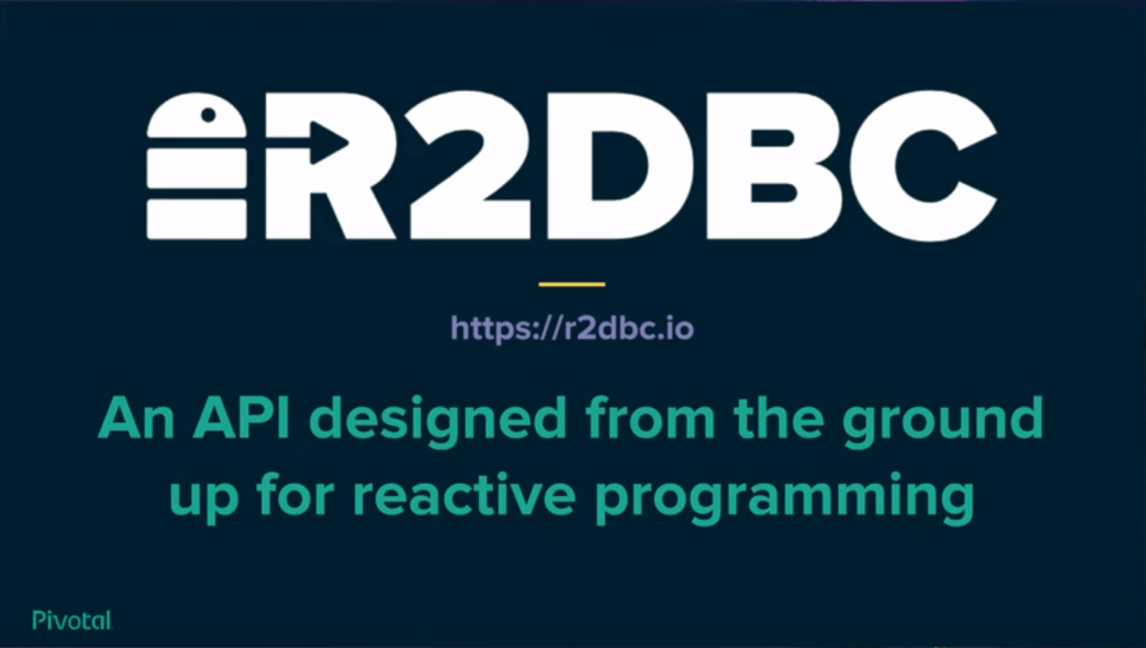

Slide 23
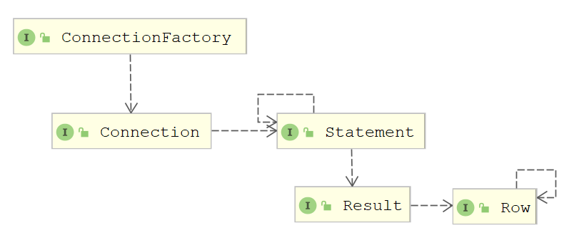
R2DBC SPEC

Slide 24




R2DBC supported databases

Slide 25

What about oracle?

Slide 26
What about oracle?
Oracle works on Asynchronous Database Access (ADBA)

Slide 27
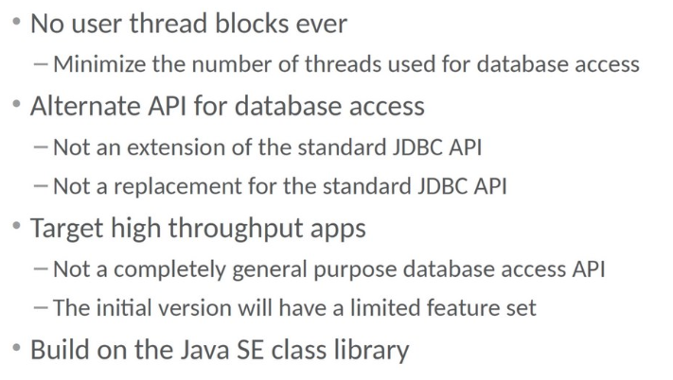
What about oracle?
Oracle works on Asynchronous Database Access (ADBA)

Slide 28
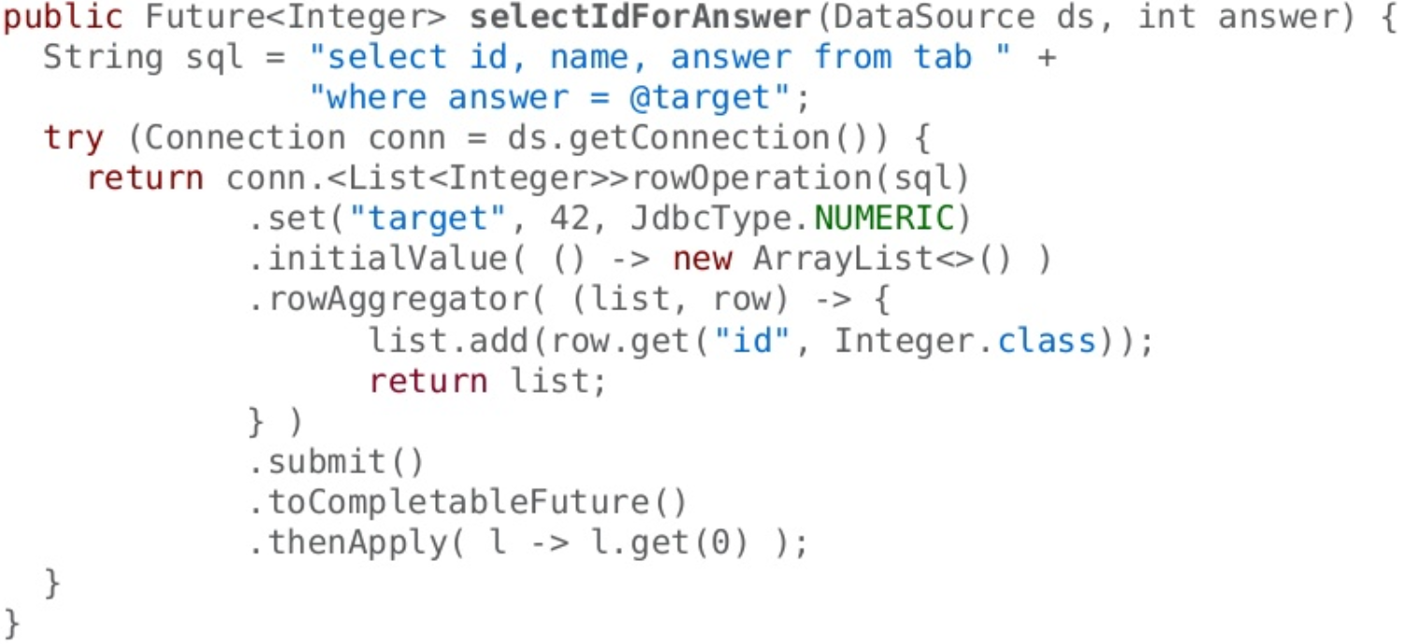
ADBA SELECT EXAMPLE

Slide 29
Let’s code: R2dbc

Slide 30


Slide 31


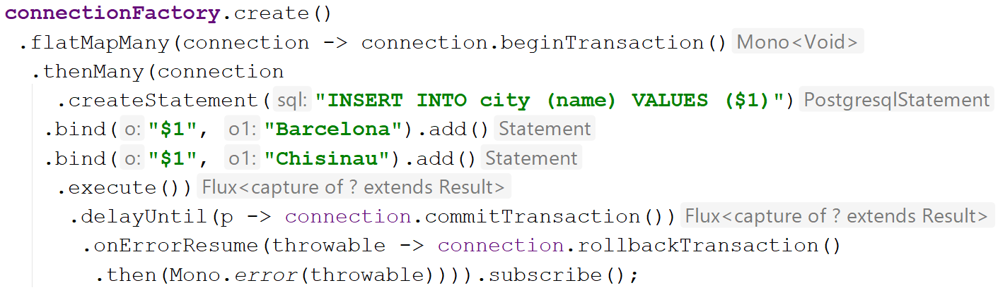

Slide 32
Let’s code: R2dbc attempt #2

Slide 33
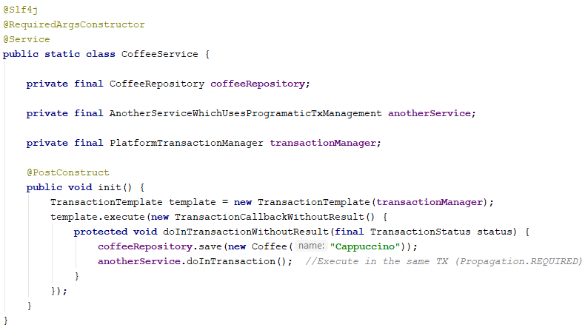
Imperative Programmatic tx management

Slide 34
reactive programmatic tx management

Slide 35
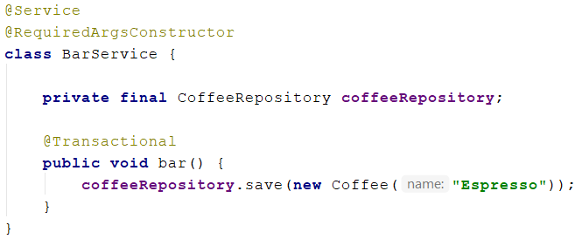
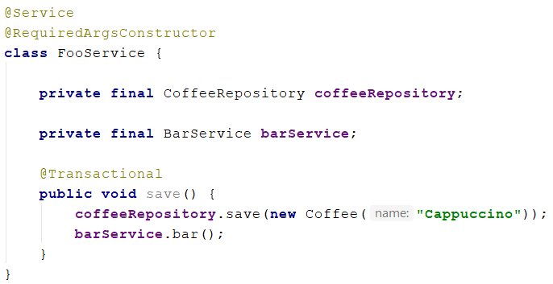
Imperative declarative tx management

Slide 36
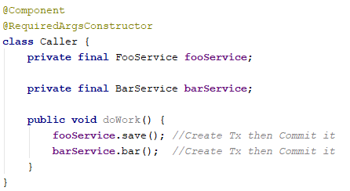
Imperative declarative tx management

Slide 37
reactive declarative tx management

Slide 38
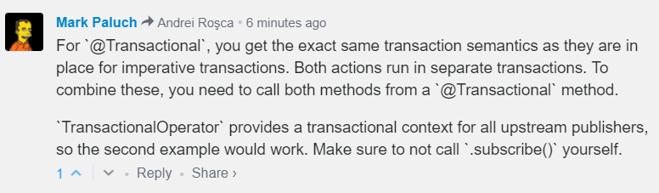
What is actually happening

Slide 39
How to debug reactive code?
Reactive programming: programming without a stack-trace since 2015

Slide 40
Obtaining back the stack-trace: reactor debug agent

Slide 41
How to Detect blocking code?
The worst sin you can commit in reactive programming is blocking

Slide 42
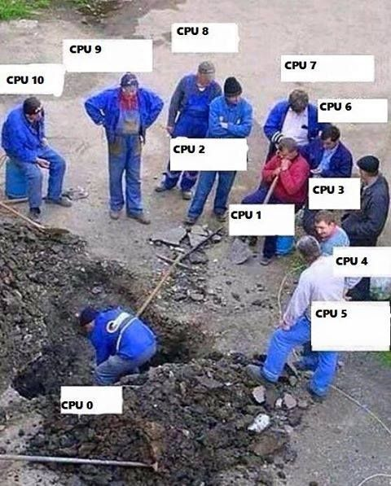
blockhound

Slide 43
Detecting blocking code: BLOCKHOUND

Slide 44
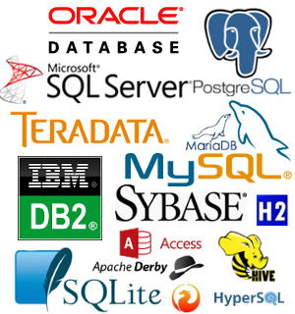
Scaling a Relational database

Slide 45
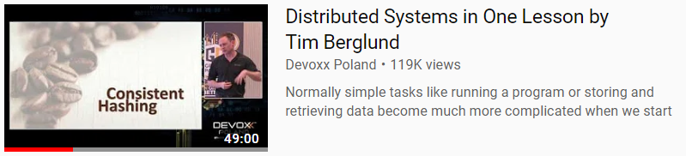
Scaling a Relational database
https://www.youtube.com/watch?v=Y6Ev8GIlbxc

Slide 46

Single-master storage

Slide 47

Read replication

Slide 48

Sharding
Aaron-Frances
Frances-Nancy
Nancy-Zed

Slide 49


Slide 50
THANK YOU
Andrei Roșca
Java developer
Andrei.Rosca@endava.com

